Slide 1

AZURE WOMEN HACKATHON 2022
TECHIES I NFUSION
FEMININE EKTA
EVOLVING WOMEN
Shruti Verma Annapoorna Singh Keerti Chouhan Sreshti Soni

Slide 2

OBJECTIVE
PROBLEM
TABLE OF CONTENT
SOLUTION
SRS FEATURES IMPACT
CONCLUSION

Slide 3
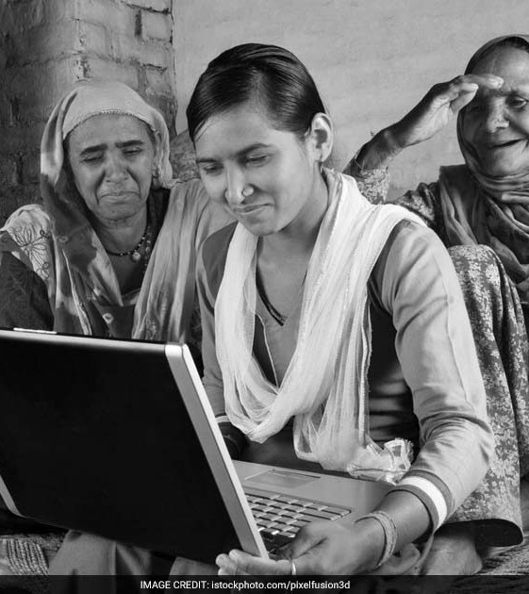
OBJECTIVE
To create a website that promotes women's sense of self-worth, their ability to make choices based on their values, and their right to affect social change for themselves, is our goal.

Slide 4
PROBLEM
Education :-
One of the main obstacles to girls' education is poverty. Another is gender-based preference.
Distance from Home and Linguistic barrier.
Lack of awareness:-
Generally, women do not know about a wide range of career opportunities and government schemes for females.
Health:-
Hospitals and other medical facilities are rare in rural areas, and if they exist, people are generally unaware of them.

Slide 5
SOLUTION
Education :-
We will provide elementary and secondary education with the help of free books and reference you tube videos for all courses.
Elementary -based on school education.
secondary -based on graduation and free online certification courses.
We provide our website in two languages Hindi or English.
Updated guidelines :-
Women will be updated on new career opportunities and government- funded scholarships and schemes through this website.
Health:-
Women in need of healthcare can find the location of nearby medical centers and hospitals through the website.

Slide 6
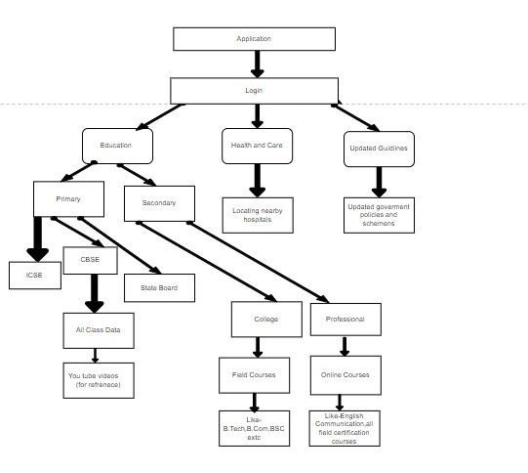

Slide 7
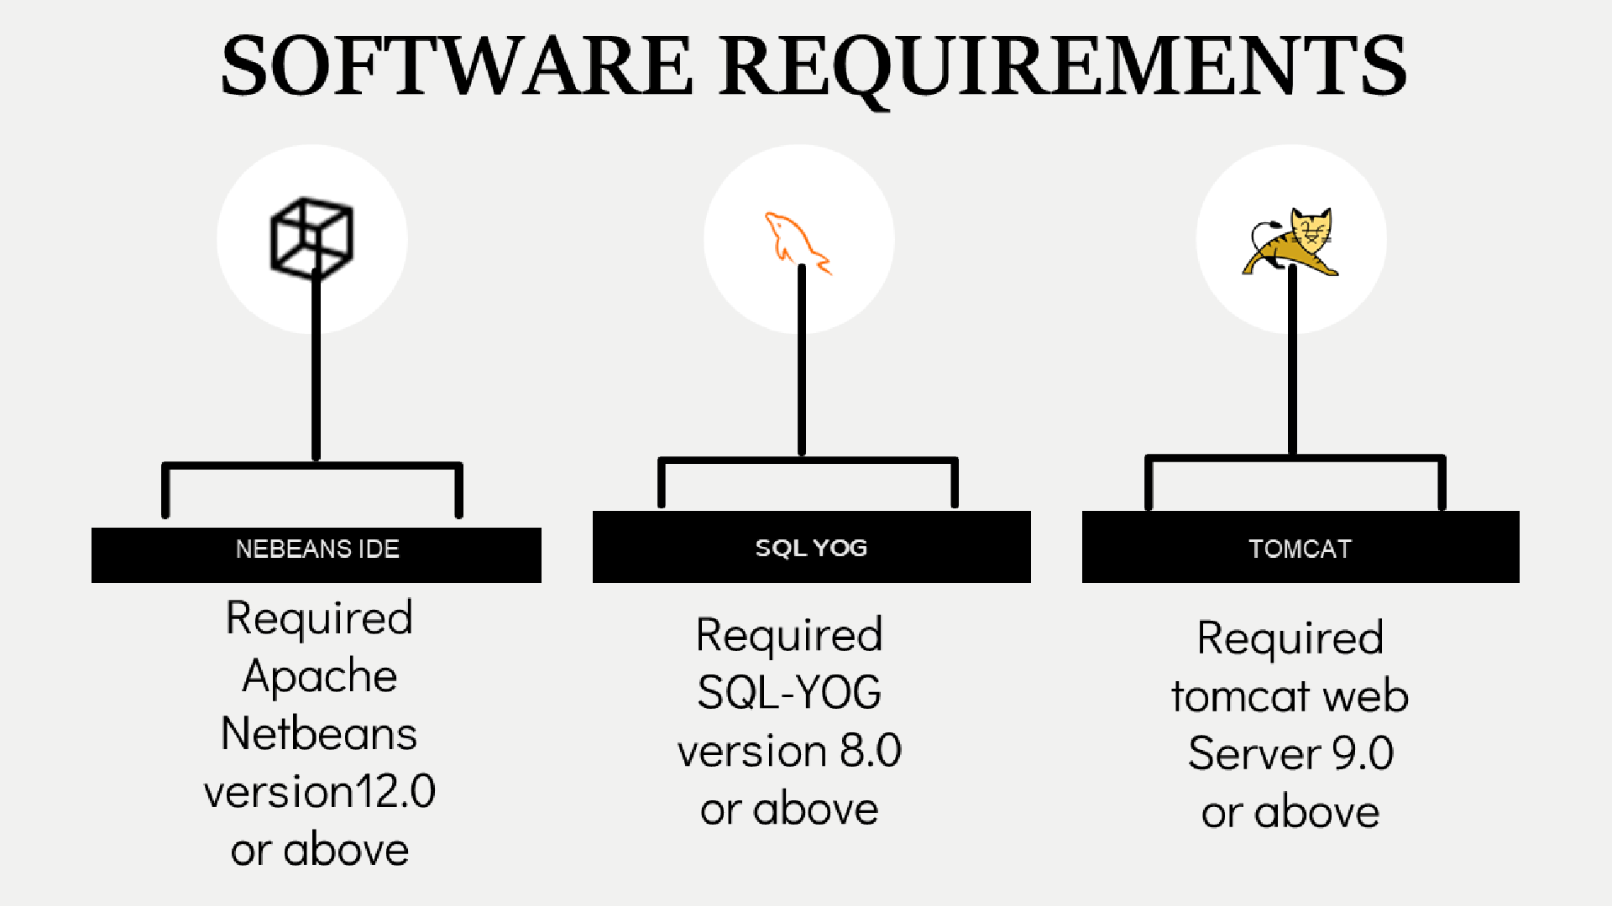

Slide 8
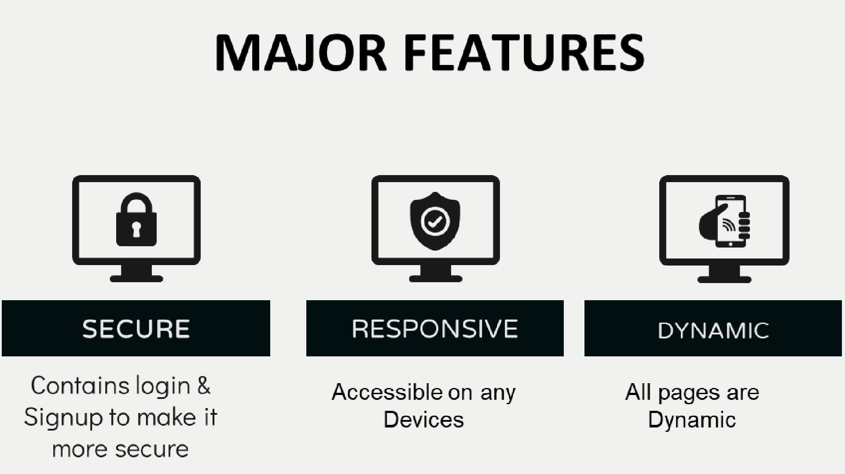

Slide 9
IMPACT
Education :-
Women in rural areas are able to obtain the basic skills of elementary and secondary level education for free.
Updated guidelines :-
Having scholarship and knowing about government schemes enable the women to utilize them in a timely manner and benefit from education.
Health:-
Women represent the cornerstone of a family’s overall health, ensuring they have access to quality care also can lead to improved health for children and families.

Slide 10
CONCLUSION
Women empowerment means empowering the women with all their rights like a man in family, society, school, college, and country.
It enables them to make independent decisions for their personal development, the position of women in Indian society is still backward due to gender inequality.
They should not be considered as the weak gender of society as they occupy about half the population of the country; they are half the strength of the country.
Women have more patience and, with their efforts, can develop the country in a better way.

